Slide 1
Strawberry River
Sub-Watershed Project
11-1100
Izard County Conservation District
Arkansas Natural Resource Commission
U.S. Environmental Protection Agency

Slide 2
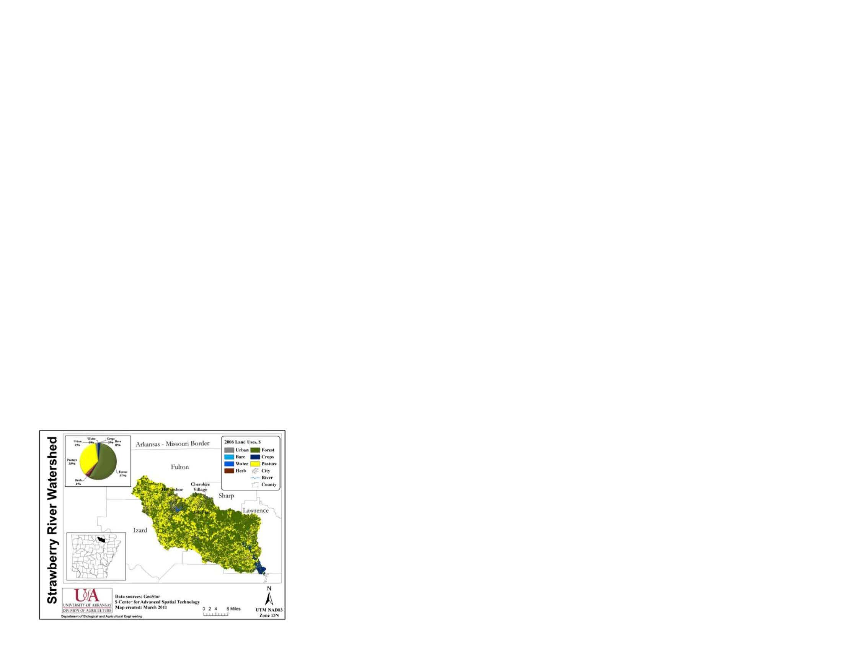
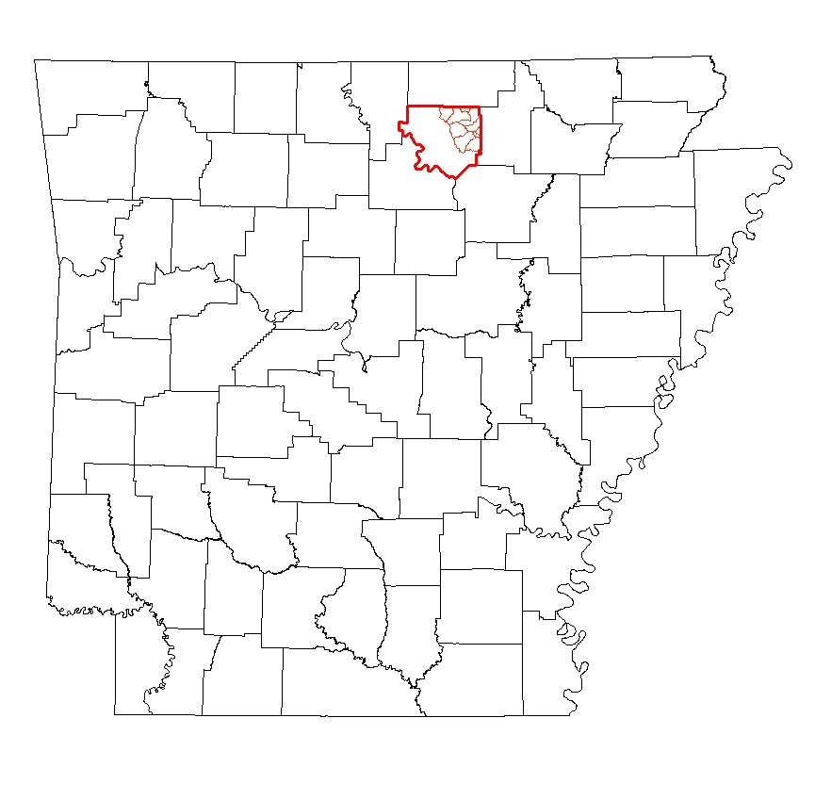
Izard County
State Location Map

Slide 3
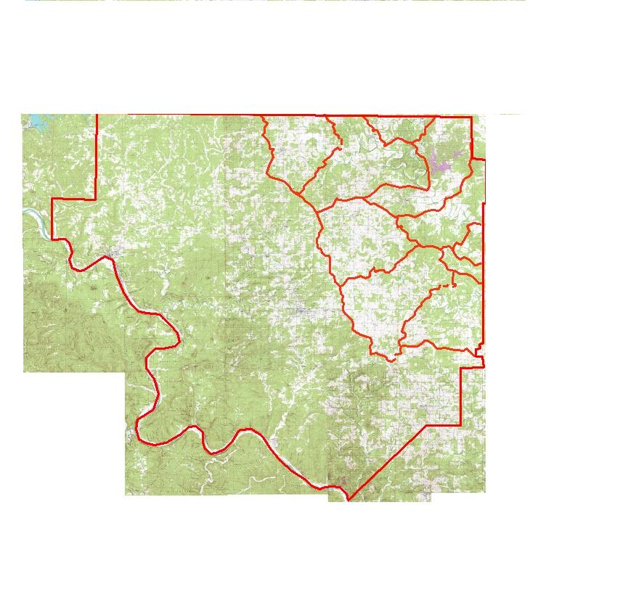
Izard County's Strawberry
Sub- Watershed Map

Slide 4
Priorities for Planning
All farms with riparian access along blue line streams as indicated on the 7.5 minute USGS quadrangle maps.
All farms that lie within 1 mile of a blue line stream.

Slide 5
Getting the word out about the project
Word of mouth
Quarterly newsletter
Annual field day and landowner conference with 72 in attendance
Equipment Rentals
Newspaper

Slide 6
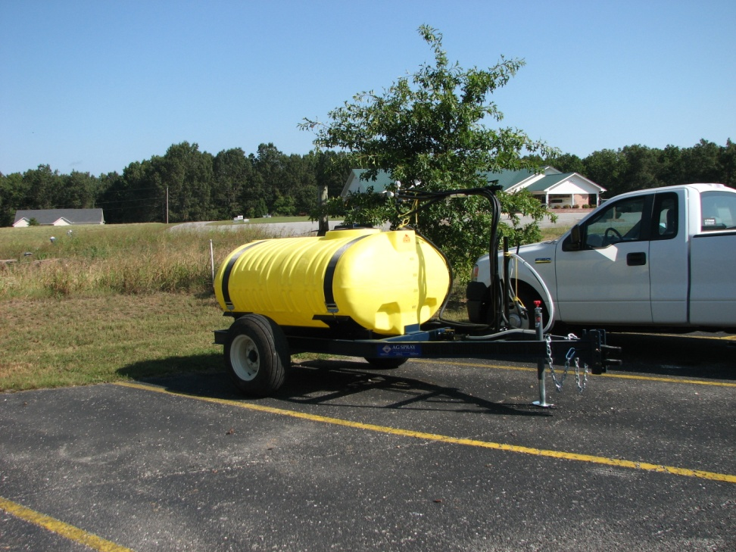
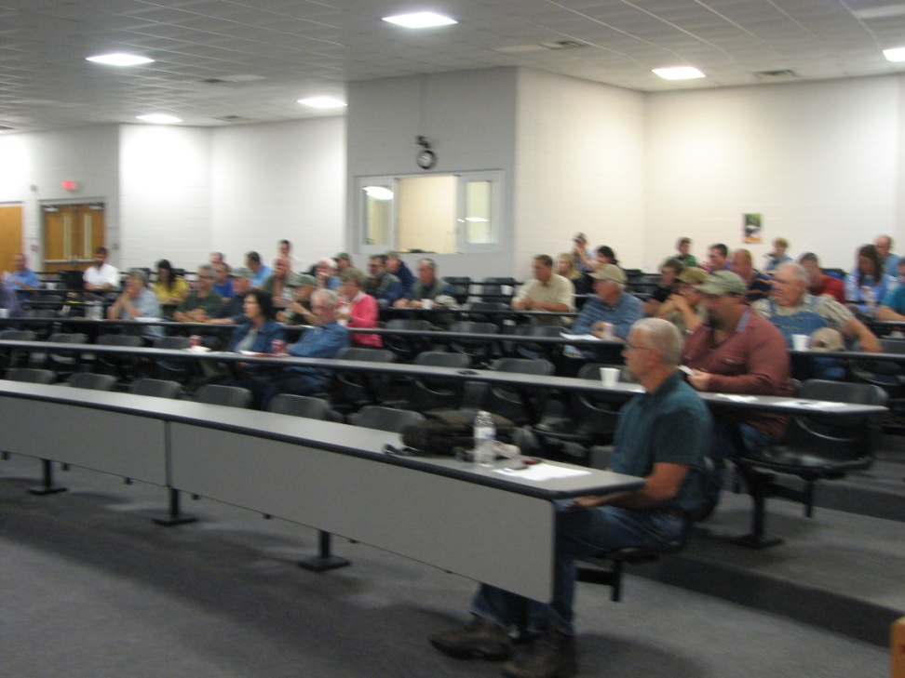
Equipment and
Landowner Conference

Slide 7
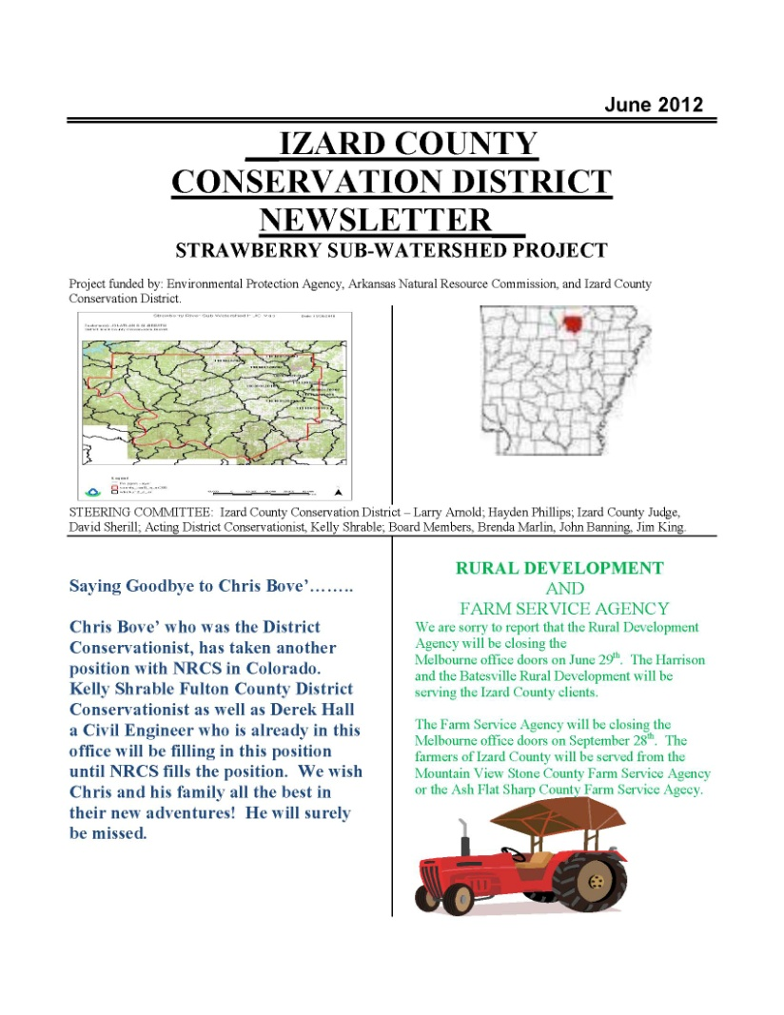
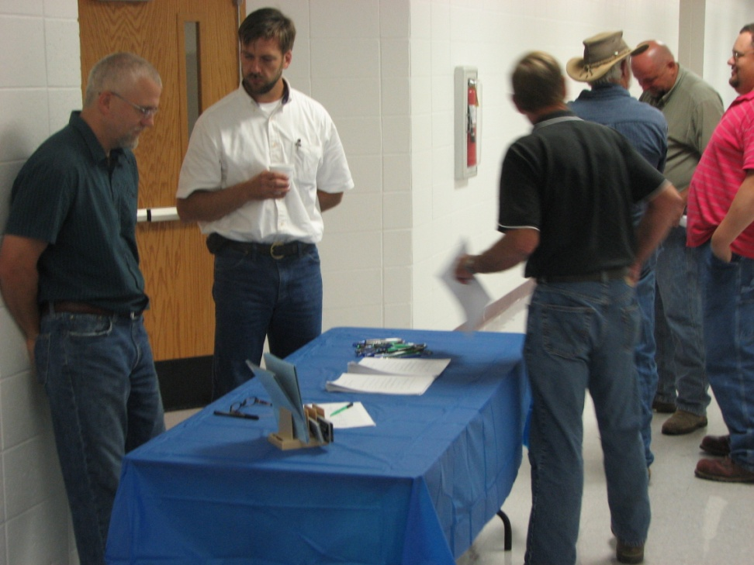
Word of mouth
Quarterly newsletter

Slide 8
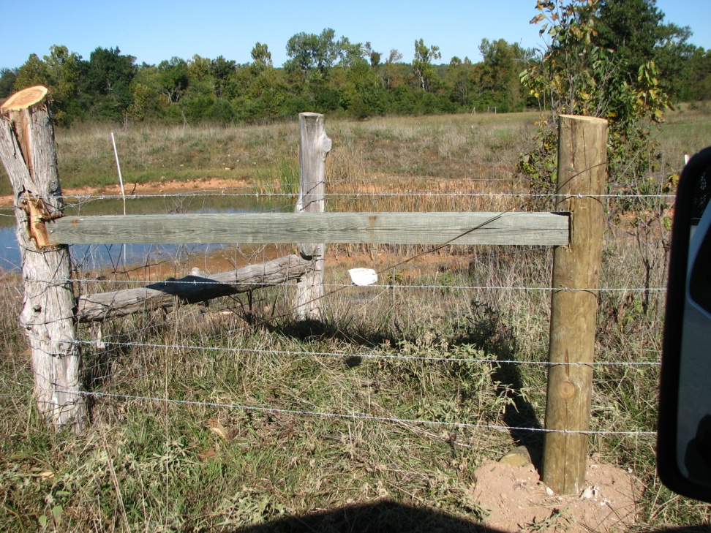
Best Management Practices
Fence 19,573 ft completed in FY 2012
Fence 30,576 planned in FY 2012

Slide 9
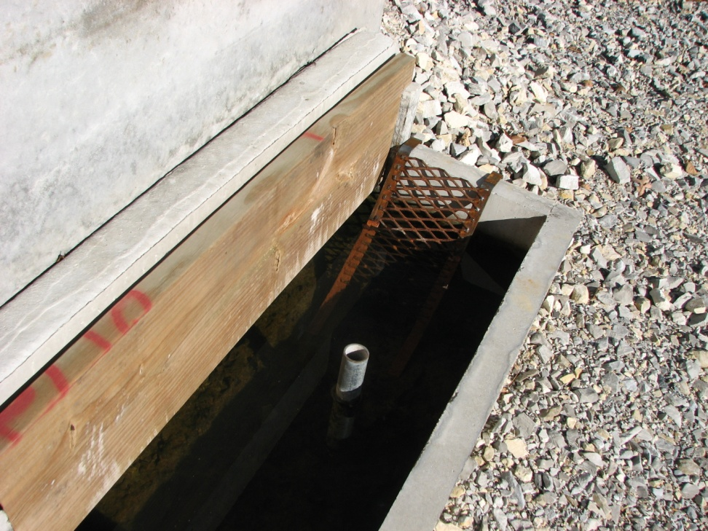
Best Management Practices
Watering Facilities = 12 planned 9 completed
Pipeline = 5412 ft planned 3434 ft completed
Heavy use protection areas = 12 planned 9 completed

Slide 10

Best Management Practices
Well = 1 planned 1 completed
Pumping Plant
(SOLAR SYSTEM) 1 planned 1 completed

Slide 11
Best Management Practices
Access Control 114 acres
Brush Management 135 acres
Pest Management 707 acres
Nutrient Management 271 acres
Prescribed Grazing 191 acres

Slide 12
Conservation Plans
51 Conservation Plans written on 4,803 acres.

Slide 13
Contracts
18 Contracts written in the last 12 months
10 Contracts completed within the last 12 months
$29,445.51 paid to landowners for installing BMP’S
$41,529.22 Match made by the landowners by installing BMP’S

